Slide 1

CEIR ETL - Training Manual

Slide 2

Agenda
ETL - Definition and Overview
Interface
Features
CDR Processing
System Flow
Impact

Slide 3
ETL - Definition
ETL stands for Extraction, Transformation and Loading. ETL is one component of RVM Mediation project
Currently, Mediation collects operator CDRs for revenue and regulatory reporting purpose.
CEIR is only interested in the mobile operator CDR serving user with SIM based mobile devices.
ETL will provide the required CDR to CEIR system.
CDR are used to:
Build whitelist IMEI database especially in grace period
Track the usage of SIM based devices in both grace and post grace period.

Slide 4
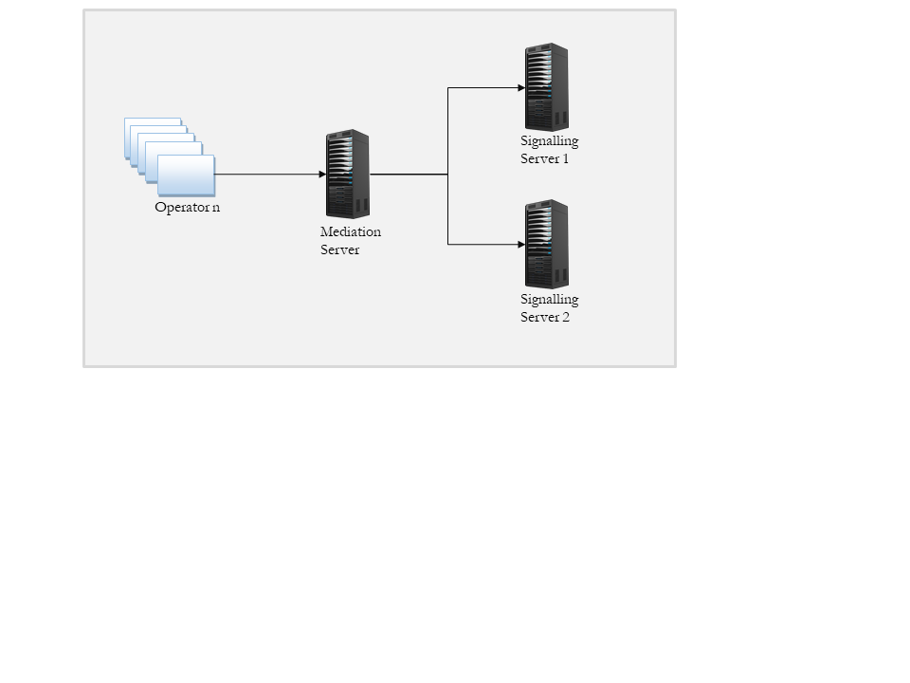

ETL – CEIR – Integration Overview
Both ETL system and signaling server are deployed in same LAN and are co-located
^{3.4 Integration Approach}
^{GSMA}
^{HTTPS Public Network HTTPS}
Diagram: Expected Integration of GSMA with CEIR system on HTTPs interface
Mediation Server
ETL System

Slide 5
Interface - Overview
File Format (csv format) has been agreed between ETL and CEIR System
Files would flow in to the ETL system as soon as they are processed by the Mediation system. ETL would process them once a day i.e. at midnight
SSH File Transfer Protocol would be used to transmit the file
Files will be pushed at one location in a round robin fashion. A folder would be provided.
Alerts are raised if:
File is not received within a defined timeframe beyond stipulated time
File is not as per the agreed format,
All file content would be same for all kind of operator like CDMA, GSM, LTE or kind of traffic like call, SMS, data

Slide 6
CDR - Overview
CDR stands for Call Data Record.
When any subscribe use the network service like MO/MT call, MO/MT SMS or data, CDR are generated.
CDR contain lots of information but key information of relevance to us is:
IMEI: IMEI of the device, which uniquely the device used in the network
MSISDN: Mobile Number of the subscriber
IMSI: SIM used by the subscriber, which identify the mobile network
System Type: Network Type like GERAN
Record Type: Type of service like MO/MT call for which CDR are generated
Each CDR may or may not populate all the above field and some of them may be absent in the CDRs.

Slide 7
CDR File - Overview
File naming convention is as follows:
File Name Convention <OPERATORNAME>_<SWITCHID>_<DDMMYYYYHHMMSS>_<SEQ>.dat
Example: SMART_MSC01_19042019134956_00000.dat
OPERATORNAME - Name of the operator
SWITCH-ID - ID of the Switch, Refer to the node which is generating the data
Sequence Number- starting from 00000 to 99999 and then repeat
File Folder naming convention is as follow:
ETL / <operator name> / <source type>/ files.
Source type can be msc/pgw. In case of CDR consolidation across all nodes, the source type would be All
File content format is as follows:
File contain the header with the following field in the given order seperated by comma: recordType, servedIMEI, servedIMSI, servedMSISDN, systemType

Slide 8
Scope of ETL for CEIR
Mediation to push the files to ETL server at the location through sftp. The signaling server can be multiple(currently there are 2 Signaling servers, in case more load is there, it can be increased to maximum 4 Signaling servers) and the files need to be send to multiple server in a round-robin fashion

Slide 9
Source – Operator node
Sr # | Operator | Source | IMEI | IMSI | MSISDN | Record_type | System_type
1 | Smart | sm_ims | Y | NA | Y | Y | NA
2 | Smart | sm_msc01 | Y (servedIMEI) | Y (servedIMSI) | Y (servedMSISDN) | Y(recordType) | Y (systemType)
3 | Smart | sm_msc02 | Y (servedIMEI) | Y (servedIMSI) | Y (servedMSISDN) | Y(recordType) | Y (systemType)
4 | Smart | sm_sgsn | Y (servedIMEI) | Y (servedIMSI) | Y (servedMSISDN) | Y(recordType) | Y (systemType)
5 | Smart | sm_SGW | Y (servedIMEI) | Y (servedIMSI) | Y (servedMSISDN) | Y(recordType) | Y (systemType)
6 | Metfone | mf_msc10 | Y (servedIMEI) | Y (servedIMSI) | Y (servedMSISDN) | Y(recordType) | Y (systemType)
7 | Metfone | mf_msc11 | Y (servedIMEI) | Y (servedIMSI) | Y (servedMSISDN) | Y(recordType) | Y (systemType)
8 | Metfone | mf_msc14 | Y (servedIMEI) | Y (servedIMSI) | Y (servedMSISDN) | Y(recordType) | Y (systemType)
9 | Metfone | mf_msc15 | Y (servedIMEI) | Y (servedIMSI) | Y (servedMSISDN) | Y(recordType) | Y (systemType)
10 | Metfone | mf_msc16 | Y (servedIMEI) | Y (servedIMSI) | Y (servedMSISDN) | Y(recordType) | Y (systemType)
11 | Metfone | mf_msc09 | Y (servedIMEI) | Y (servedIMSI) | Y (servedMSISDN) | Y(recordType) | Y (systemType)
12 | Metfone | mf_sgsn1 | Y (servedIMEI) | Y (servedIMSI) | Y (servedMSISDN) | Y(recordType) | Y (systemType)
13 | Seatel | st_p_gw | Y (servedIMEISV) | Y (servedIMSI) | Y (servedMSISDN) | Y(recordType) | NA
14 | Cellcard | cc_ggsn | Y (servedIMEISV) | Y (servedIMSI) | Y (servedMSISDN) | Y(recordType) | NA
15 | Cellcard | cc_zmsc71 | Y (servedIMEI) | Y (servedIMSI) | Y (servedMSISDN) | Y(recordType) | Y (systemType)
16 | Cellcard | cc_zmsc72 | Y (servedIMEI) | Y (servedIMSI) | Y (servedMSISDN) | Y(recordType) | Y (systemType)
17 | Cellcard | cc_zmsc73 | Y (servedIMEI) | Y (servedIMSI) | Y (servedMSISDN) | Y(recordType) | Y (systemType)
Total 19 sources
5 Mobile operators
New Source/Operator can be added in the system

Slide 10
CDR – Processing Sequence
Key Points
Rules are processed as defined for the user
Rule can be different for different period.
Rule (in the given order)
Exception rule like VIP
Static Rule like length, character set
Dynamic rule like tax paid DB
Read CDR
Apply A Rule
Failed
Take Action
No
Passed
All rules applied
Yes
Take Action and update DB

Slide 11
Impact
As part of the work flow, key critical DB is created, which is used for policy implementation
Usage Database
Triplet Information (IMEI, MSISDN and IMSI) is maintained in this database
Device Reporting (Type of devices used in network)
Duplicate Database
Same IMEI may be assigned to different MSISDN
NULL IMEI Database
Will contain list of MSISDN/IMSI combination whose IMEI is null
Whitelist Database
All invalid device found in grace period would be allowed to work in network.

Slide 12
Policy / Rules
Grace Period
Minimal Policy to be applied to be able to build Whitelist
To avoid any hassles to end user for any device that they are already using
Post Grace Period
All Policy would be in place in this period.

Slide 13
Action – per IMEI Basis
System Regularization – The device would be regularized by system in grace period, wherein all the devices will be allowed to operate in the network irrespective of policy violation
User Regularization – The device would be regularized by user in post grace period, where the blocking/unblocking of device in network will depend on the user action against the policy violation notification
Blocked – The device usage has been restricted from use in the network
Allowed – The device usage is permitted for use in the network

Slide 14
Queries

Slide 15
Thank You

